Slide 1

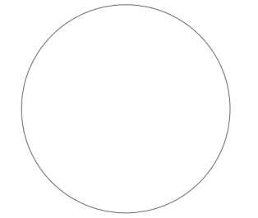

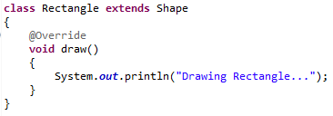
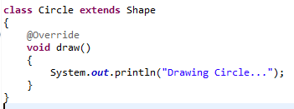
Abstract class in Java
In this example, Shape the abstract class that contains only one abstract method draw. Its implementation is provided by the Rectangle and Circle classes.
extends
extends

